Slide 1
Optimization Functions
Gradient Descent, Momentum, AdaGrad (Adaptive Gradient), Adadelta (Adaptive Delta), RMSProp (Root Mean Squared Propagation), Adam (Adaptive Moment Estimation)

Slide 2
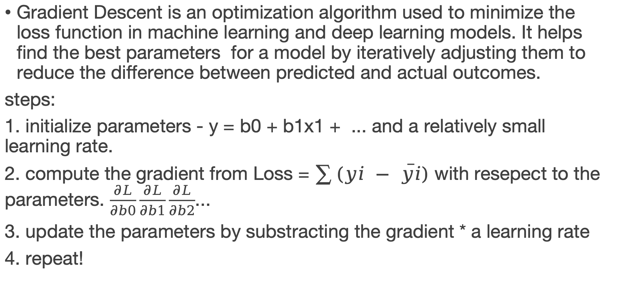
Gradient Descent
Gradient Descent is an optimization algorithm used to minimize the loss function in machine learning and deep learning models. It helps find the best parameters for a model by iteratively adjusting them to reduce the difference between predicted and actual outcomes.
steps:
1. initialize parameters - y = b0 + b1x1 + ... and a relatively small learning rate.
2. compute the gradient from Loss = $\sum{(yi − \overline{yi})}$ with resepect to the parameters. $\frac{∂L}{∂b0}\frac{∂L}{∂b1}\frac{∂L}{∂b2}$...
3. update the parameters by substracting the gradient * a learning rate
4. repeat!

Slide 3
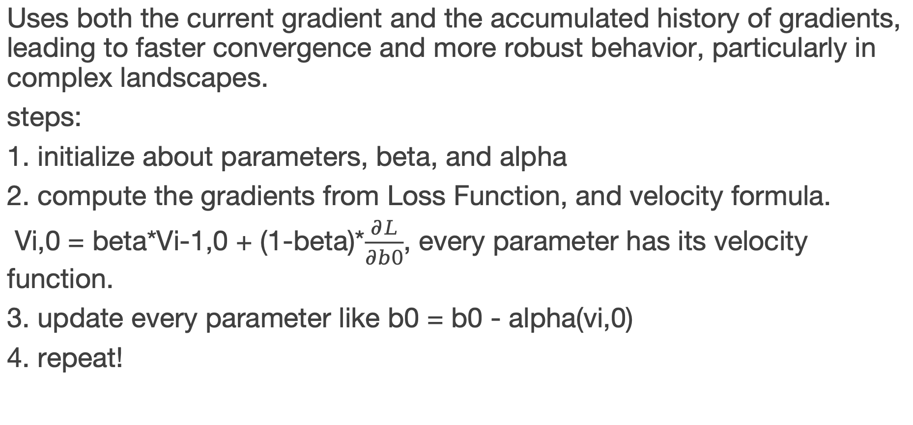
Momentum
Uses both the current gradient and the accumulated history of gradients, leading to faster convergence and more robust behavior, particularly in complex landscapes.
steps:
1. initialize about parameters, beta, and alpha
2. compute the gradients from Loss Function, and velocity formula.
Vi,0 = beta*Vi-1,0 + (1-beta)*$\frac{∂L}{∂b0}$, every parameter has its velocity function.
3. update every parameter like b0 = b0 - alpha(vi,0)
4. repeat!

Slide 4
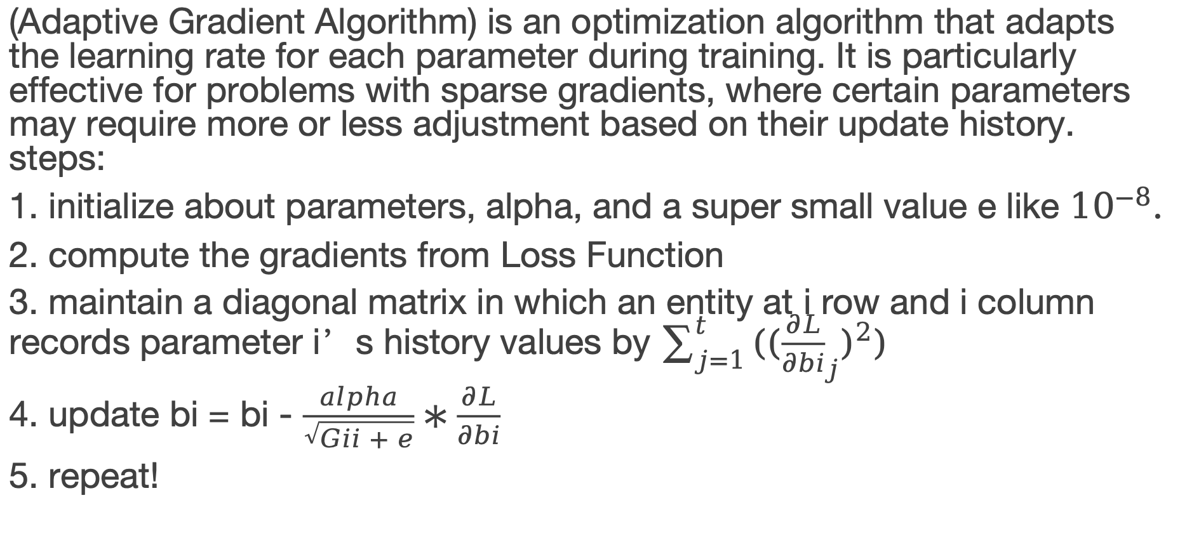
AdaGrad
(Adaptive Gradient Algorithm) is an optimization algorithm that adapts the learning rate for each parameter during training. It is particularly effective for problems with sparse gradients, where certain parameters may require more or less adjustment based on their update history. steps:
1. initialize about parameters, alpha, and a super small value e like ${10}^{−8}.$
2. compute the gradients from Loss Function
3. maintain a diagonal matrix in which an entity at i row and i column records parameter i’s history values by $\sum_{j=1}^{t}{({({\frac{∂L}{∂bi}}_{j})}^{2})}$
4. update bi = bi - $\frac{alpha}{\sqrt{Gii + e}}∗\frac{∂L}{∂bi}$
5. repeat!

Slide 5
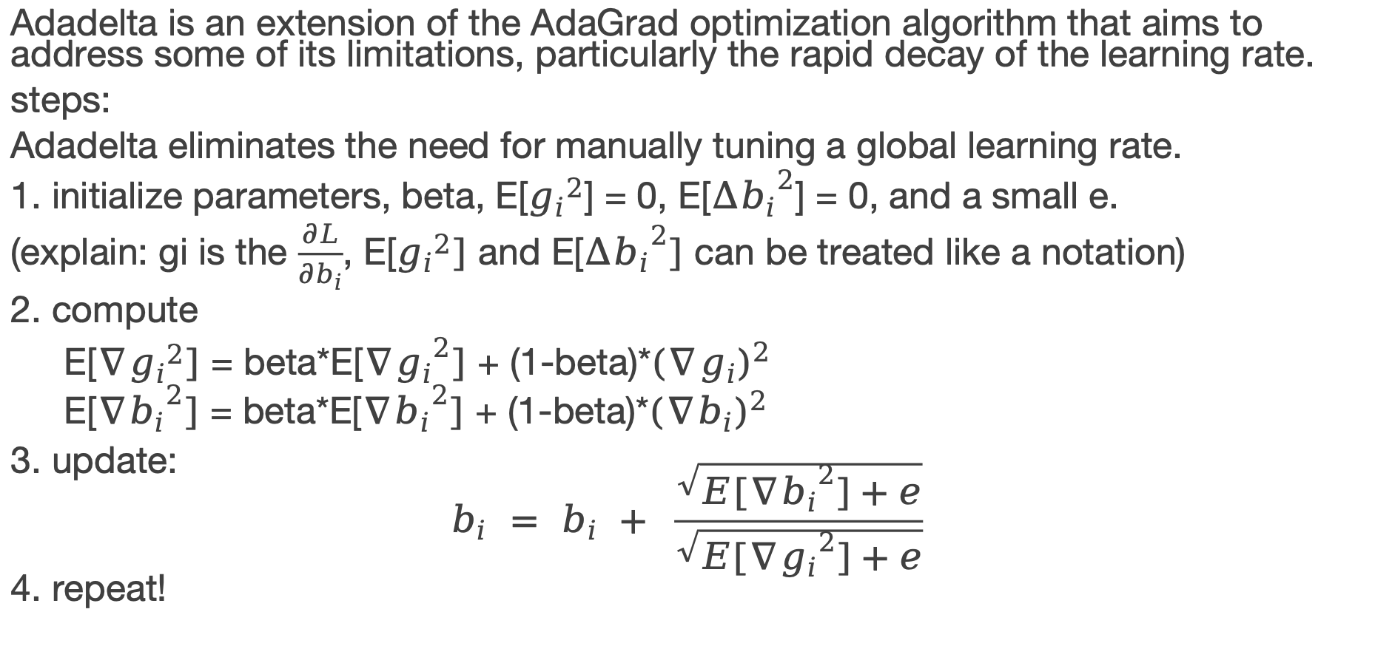
Adadelta
Adadelta is an extension of the AdaGrad optimization algorithm that aims to address some of its limitations, particularly the rapid decay of the learning rate.
steps:
Adadelta eliminates the need for manually tuning a global learning rate.
1. initialize parameters, beta, E[${g_{i}}^{2}$] = 0, E[${∆b_{i}}^{2}$] = 0, and a small e.
(explain: gi is the $\frac{∂L}{∂b_{i}}$, E[${g_{i}}^{2}]$ and E[${∆b_{i}}^{2}]$ can be treated like a notation)
2. compute
E[$∇{g_{i}}^{2}]$ = beta*E[${{∇g}_{i}}^{2}]$ + (1-beta)*${({∇g}_{i})}^{2}$
E[${{∇b}_{i}}^{2}]$ = beta*E[${{∇b}_{i}}^{2}]$ + (1-beta)*${({∇b}_{i})}^{2}$
3. update:
$$b_{i} = b_{i} + \frac{\sqrt{E[∇{b_{i}}^{2}]+e}}{\sqrt{E[{{∇g}_{i}}^{2}]+e}}$$
4. repeat!

Slide 6
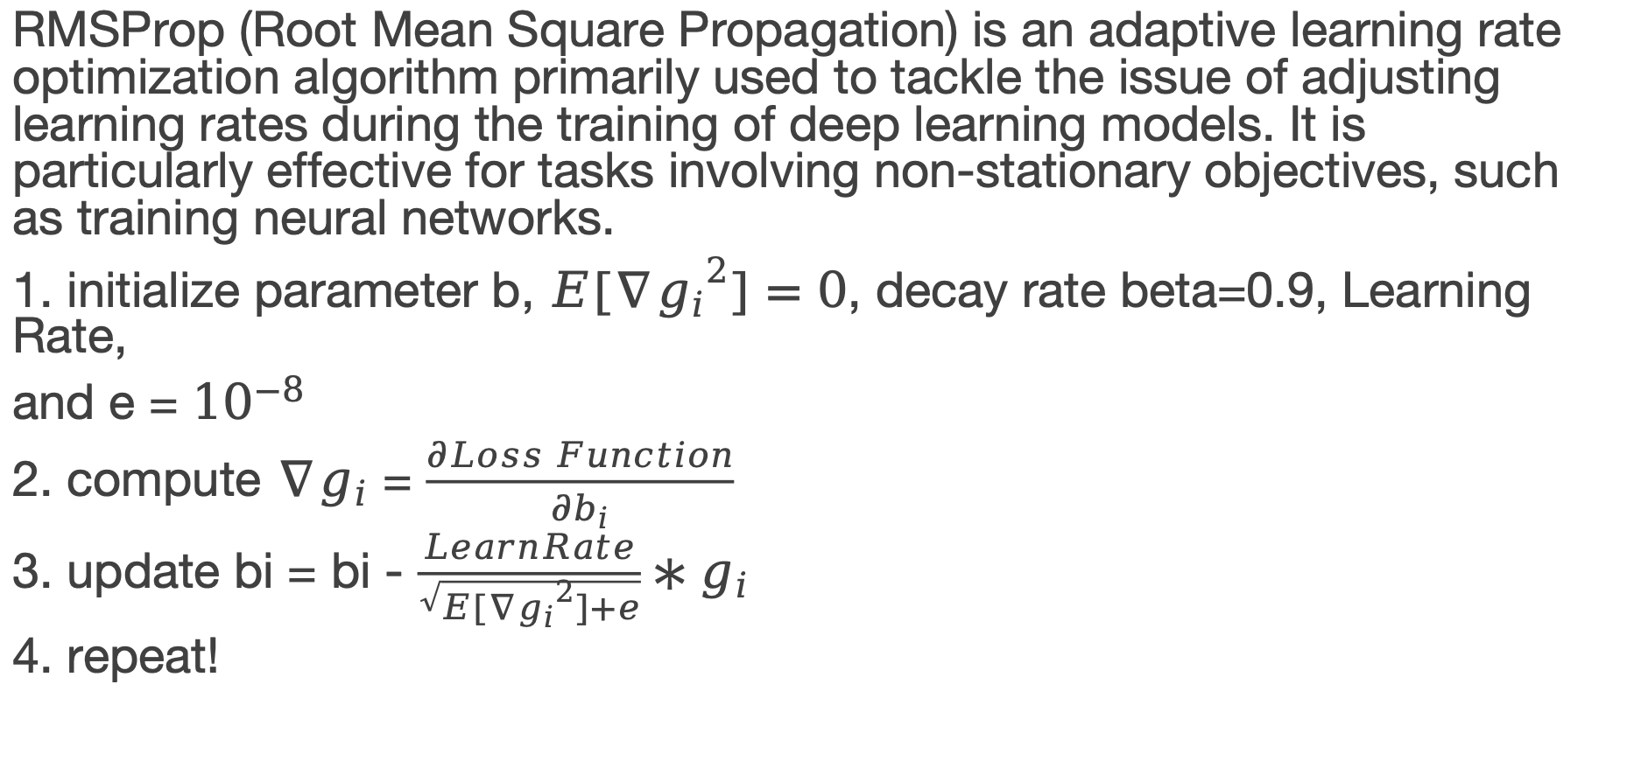
RMSProp
RMSProp (Root Mean Square Propagation) is an adaptive learning rate optimization algorithm primarily used to tackle the issue of adjusting learning rates during the training of deep learning models. It is particularly effective for tasks involving non-stationary objectives, such as training neural networks.
1. initialize parameter b, $E[{{∇g}_{i}}^{2}]=0$, decay rate beta=0.9, Learning Rate,
and e = ${10}^{−8}$
2. compute ${∇g}_{i}$ = $\frac{∂Loss Function}{∂b_{i}}$
3. update bi = bi - $\frac{LearnRate}{\sqrt{E[{{∇g}_{i}}^{2}]+e}}∗g_{i}$
4. repeat!

Slide 7
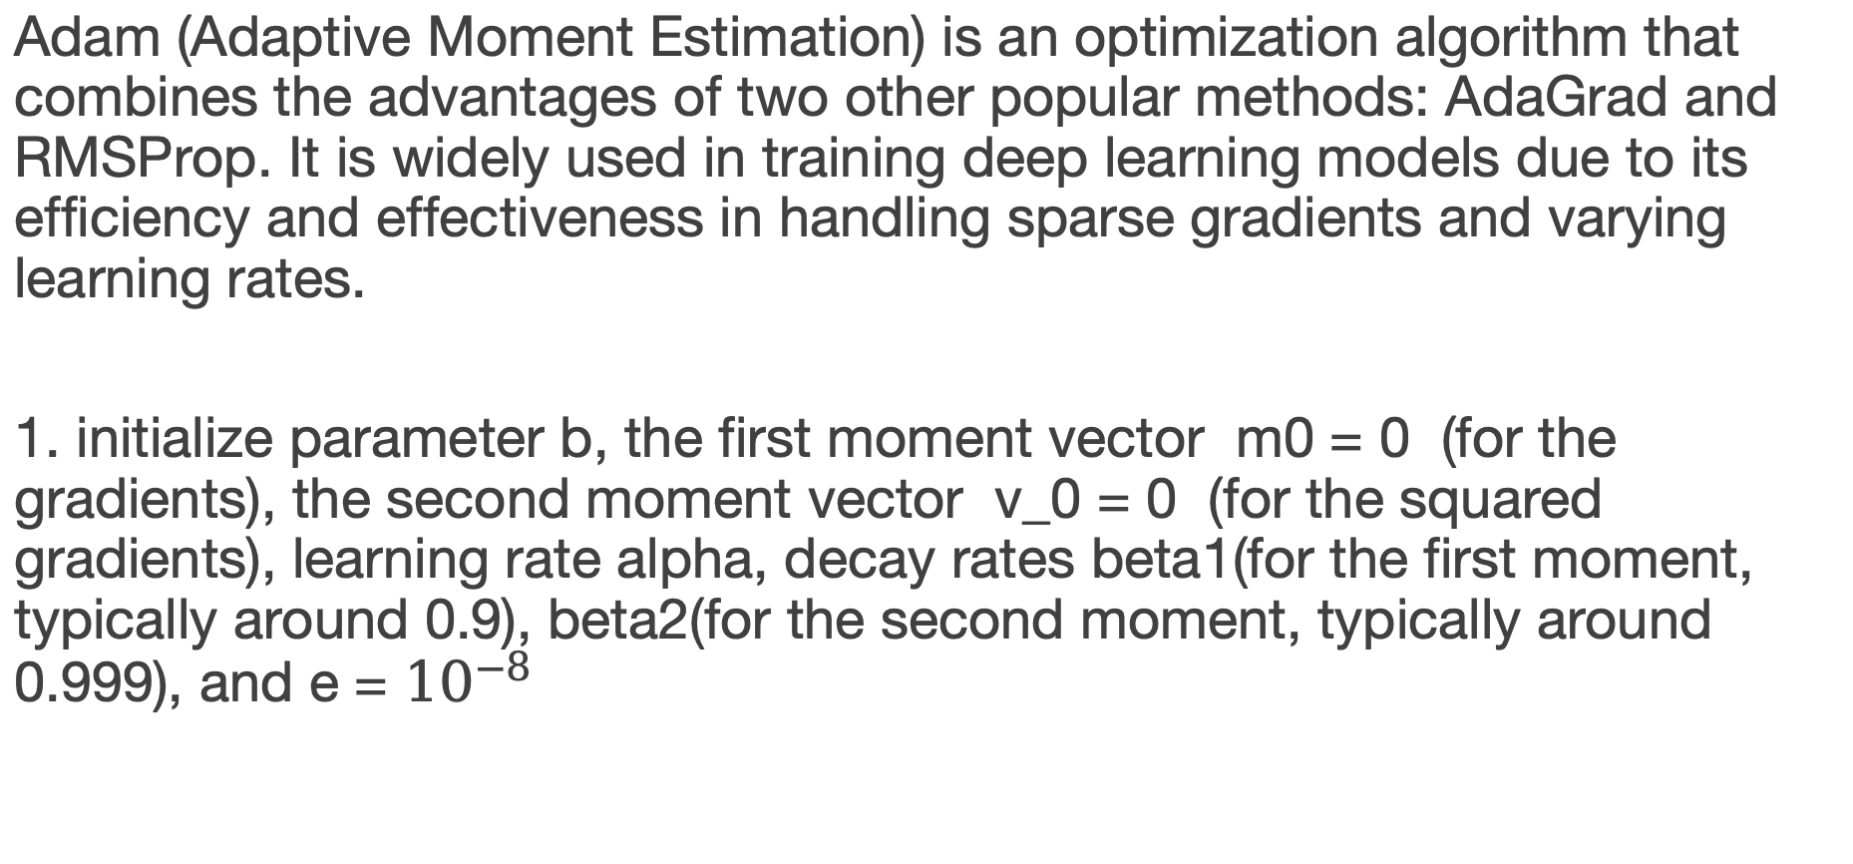
Adam
Adam (Adaptive Moment Estimation) is an optimization algorithm that combines the advantages of two other popular methods: AdaGrad and RMSProp. It is widely used in training deep learning models due to its efficiency and effectiveness in handling sparse gradients and varying learning rates.
1. initialize parameter b, the first moment vector m0 = 0 (for the gradients), the second moment vector v_0 = 0 (for the squared gradients), learning rate alpha, decay rates beta1(for the first moment, typically around 0.9), beta2(for the second moment, typically around 0.999), and e = ${10}^{−8}$

Slide 8
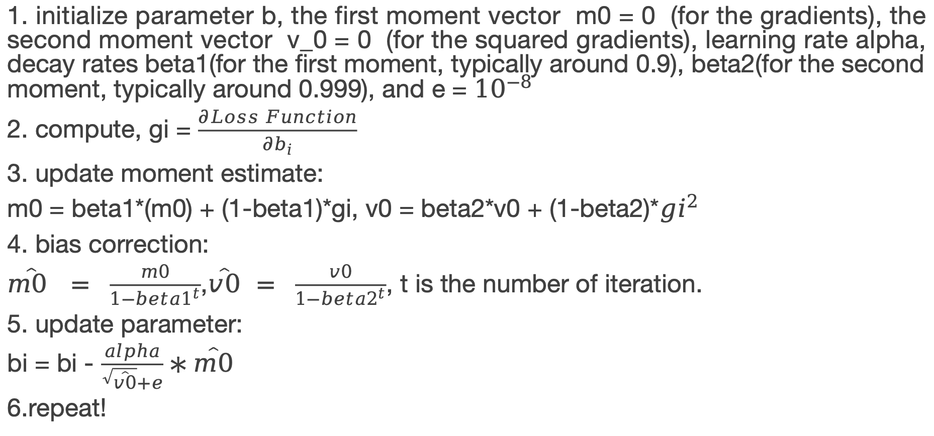
Adam
1. initialize parameter b, the first moment vector m0 = 0 (for the gradients), the second moment vector v_0 = 0 (for the squared gradients), learning rate alpha, decay rates beta1(for the first moment, typically around 0.9), beta2(for the second moment, typically around 0.999), and e = ${10}^{−8}$
2. compute, gi = $\frac{∂Loss Function}{∂b_{i}}$
3. update moment estimate:
m0 = beta1*(m0) + (1-beta1)*gi, v0 = beta2*v0 + (1-beta2)*${gi}^{2}$
4. bias correction:
$\hat{m0 } = \frac{m0}{1−{beta1}^{t}}$,$\hat{v0} = \frac{v0}{1−{beta2}^{t}}$, t is the number of iteration.
5. update parameter:
bi = bi - $\frac{alpha}{\sqrt{\hat{v0}}+e}∗\hat{m0}$
6.repeat!

